Slide 1


Committed to the growth of ALL: Students, Families, Community
2022-23
Proposed Budget

Slide 2
DISTRICT BUDGET
Fiscal Year: July 1 - June 30
Budget Finalized in October by School Board

Slide 3
Major Budget Factors
Property Value – October 1
Student Enrollment - 3rd Friday in September
Transfer of Service
Private School Voucher Aid Deduction – October 15
State Aid - October 15
District Adjustments

Slide 5
PROPERTY VALUATION
13.35%

Slide 6

Revenue Limit Membership

Slide 7
ENROLLMENT -- PREVIOUS & PROJECTED FUTURE
(4k, PAA not included)

Slide 8


Operational Referendum
Operational Dollars Available = $48,000,000
Total Unspent/Untaxed Referendum Dollars = $10,426,185
$1.5 million/year $2.6 million/year $3.7M/year

Slide 9

Budget Revenues:
State Aid (53%) and Taxes (40%)
Budget Expenses:
Salaries (44.9%)
Employee Benefits (17.8%)
Pupil Travel (5.1%)
Utilities (2.7%)
Open Enrollment (7.7%)
Other purchase & repair costs (10.7%)
Equipment purchases/Lease (4.6%)
Property & Casualty Insurance (1.6%)
Operating Transfer – Fund 46 (4.9%)

Slide 10
Funds that Impact the Levy:
GENERAL FUND (FUND 10)
$29,700,875 (w/o grants)
  Note: District does not currently levy taxes for any other funds (e.g. debt service, capital projects or community service)

Slide 11
TAX LEVY

Slide 12
Each Municipality’s share of the levy
is determined by its share of the total equalized value.

Slide 13
PROJECTED TAX IMPACT
$6.80 Mill Rate
$150,000 Home
$1,020 School Tax Amount

Slide 14
Tax Rate – History

Slide 16

Note:
  Budget adjustments are made in October
  based on student enrollment, state aid
  certification, transfer of service allocation,
  district adjustments, the state voucher
  program, and property valuations.

Slide 17
Annual Meeting Packet
DPI Recommended Format
        Does include some State/Federal Grants

Slide 18
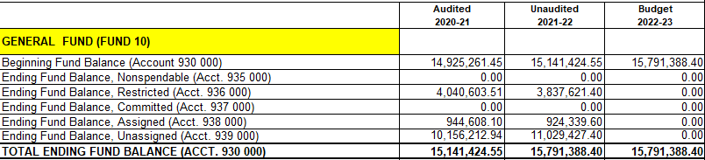


FUND BALANCE

Slide 19
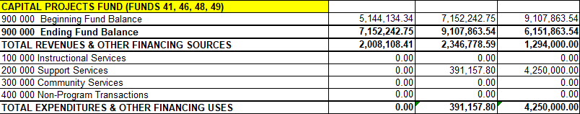


CAPITAL IMPROVEMENTS

Slide 20

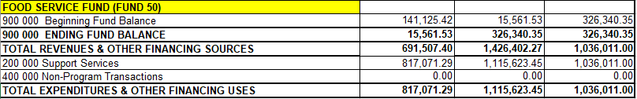


FOOD SERVICE

Slide 21

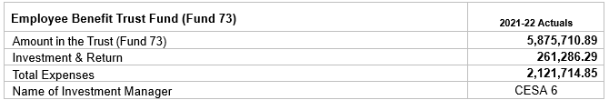

Employee Benefit Trust

Slide 23
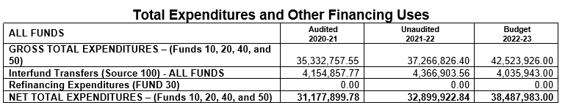
10 Fd. Federal Sources increase (558,227)
46 Fd. Expenditures (3,858,843)
34,070,913
3.55%

Slide 24
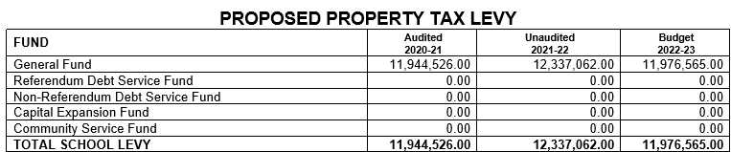

TAX LEVY

Slide 25
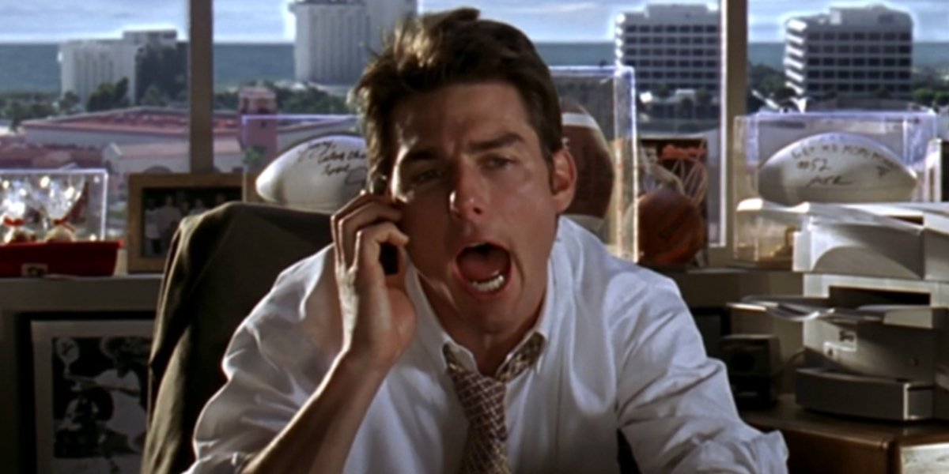
Thank you for “Showing Me The Money” – Now, I’ll vote “YES” on the budget

